Slide 1
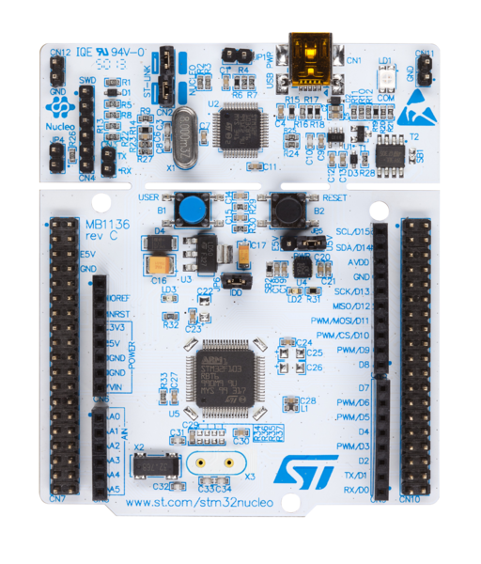
15 V
Raspberry PI 3
Serial.read()
M
M
ESC
ESC
PWM_PIN1
PWM_PIN2

